Slide 1
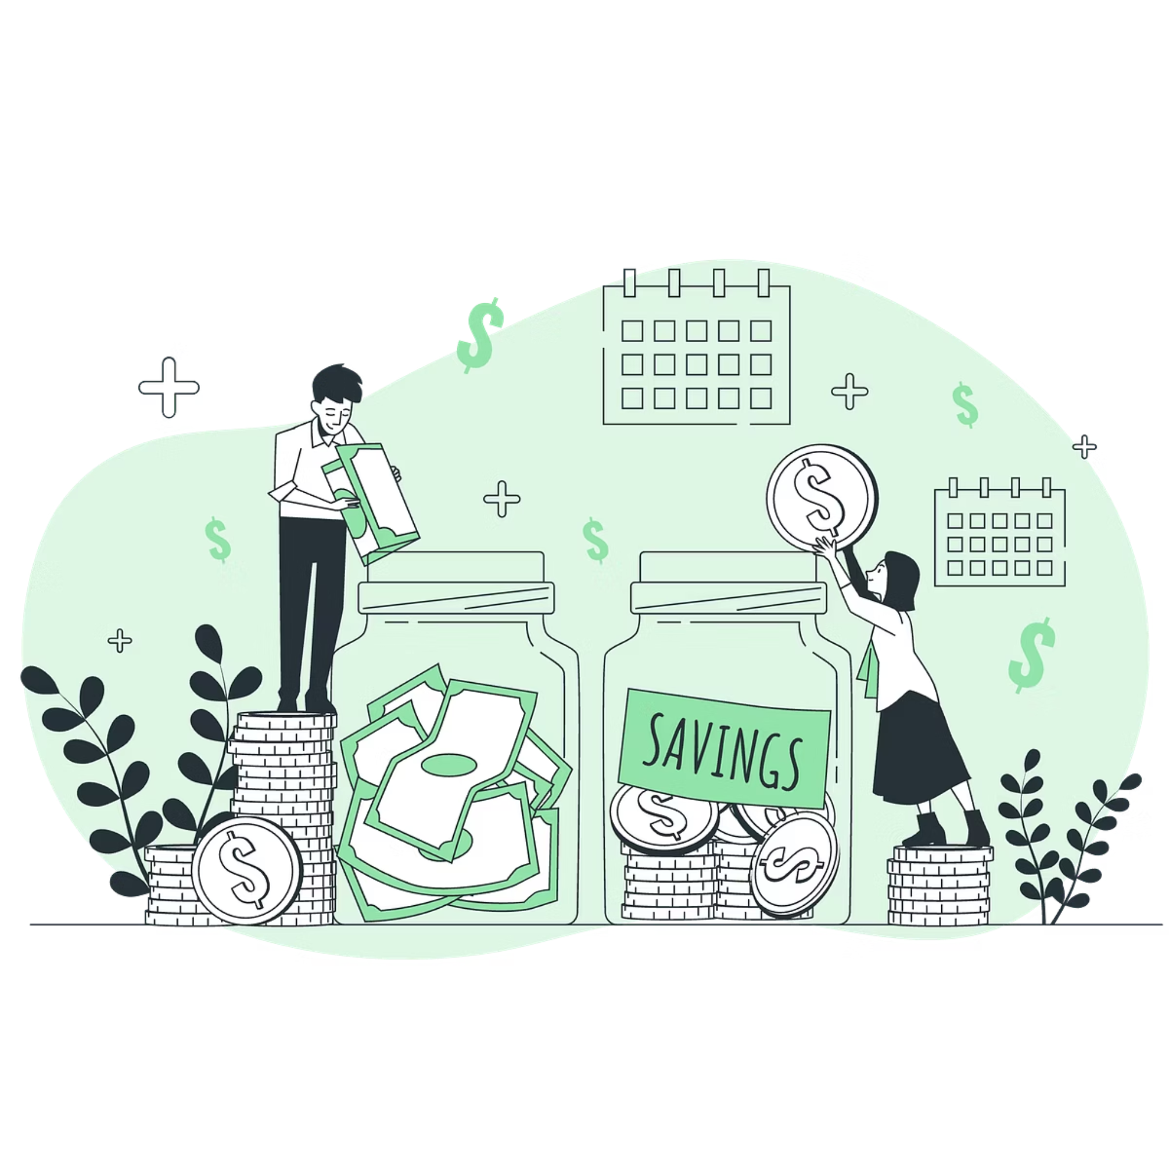
UniFund
The Financial Assistant for students
community-driven financial app that gamifies saving through leader boards, streaks, and shared student money hacks.

Slide 2
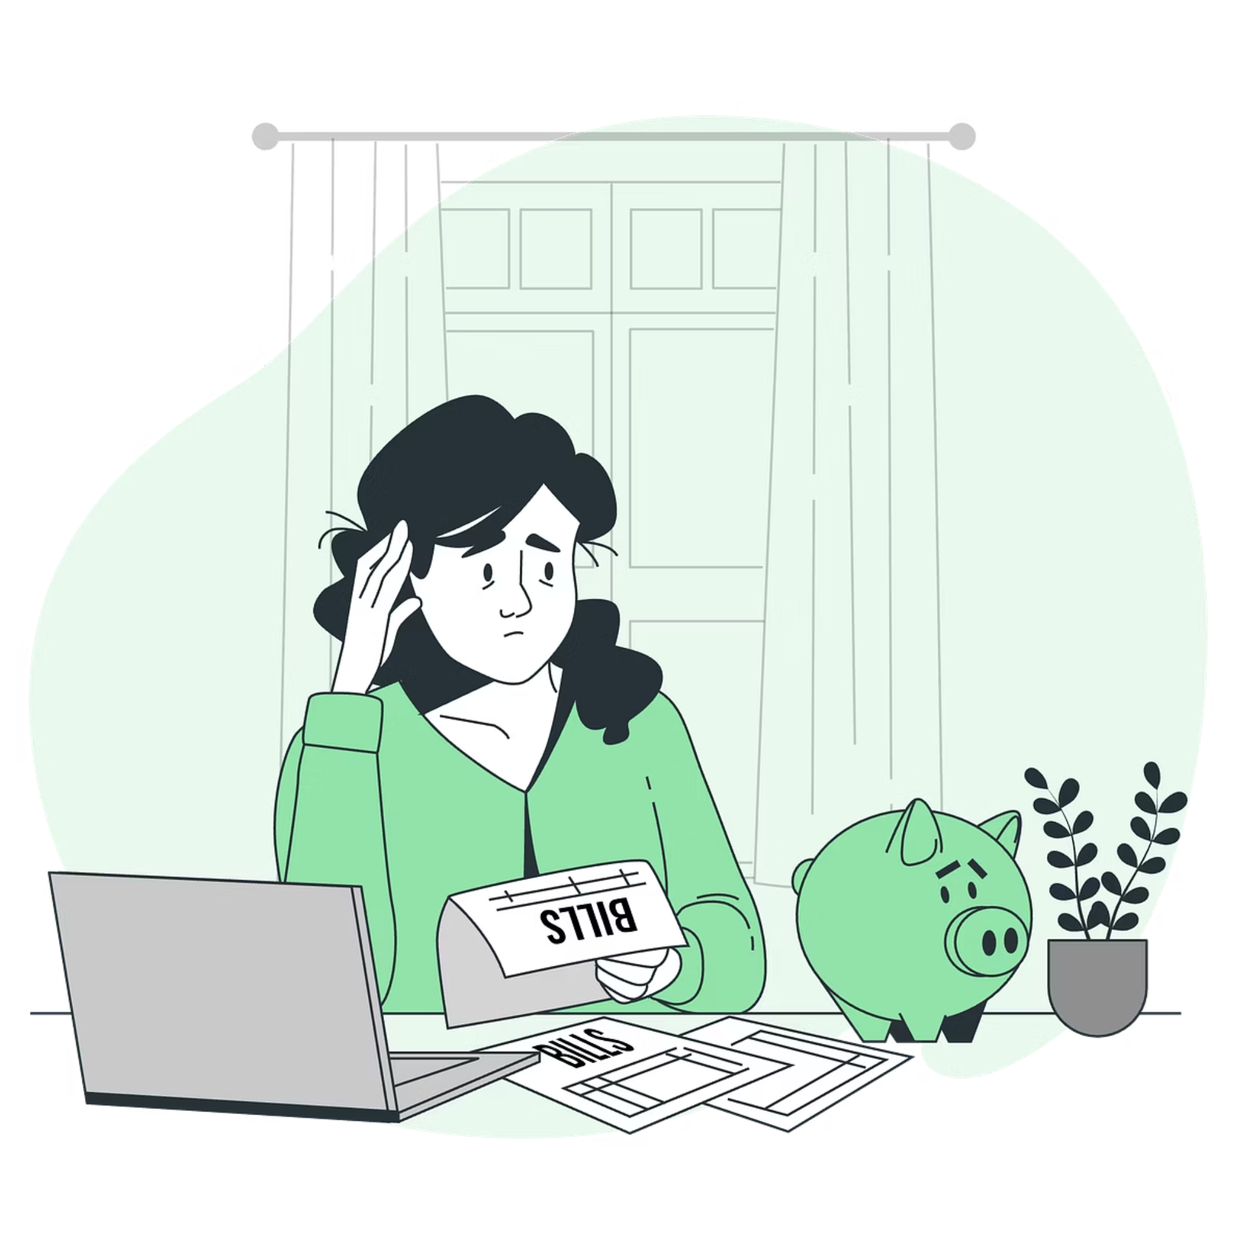
The Problem
1. Lack of Saving Motivation
2. Poor Spending Awareness
3. Scattered Student Benefits
Students struggle to consistently save without accountability or incentives.
No clear visibility of runway, savings progress, or real-time expense behaviour.
Cheap deals, offers, and money-saving hacks are fragmented across multiple platforms.
4. Exchange Rate UncertaintyStudents lose money due to poor timing in currency exchange decisions.

Slide 3
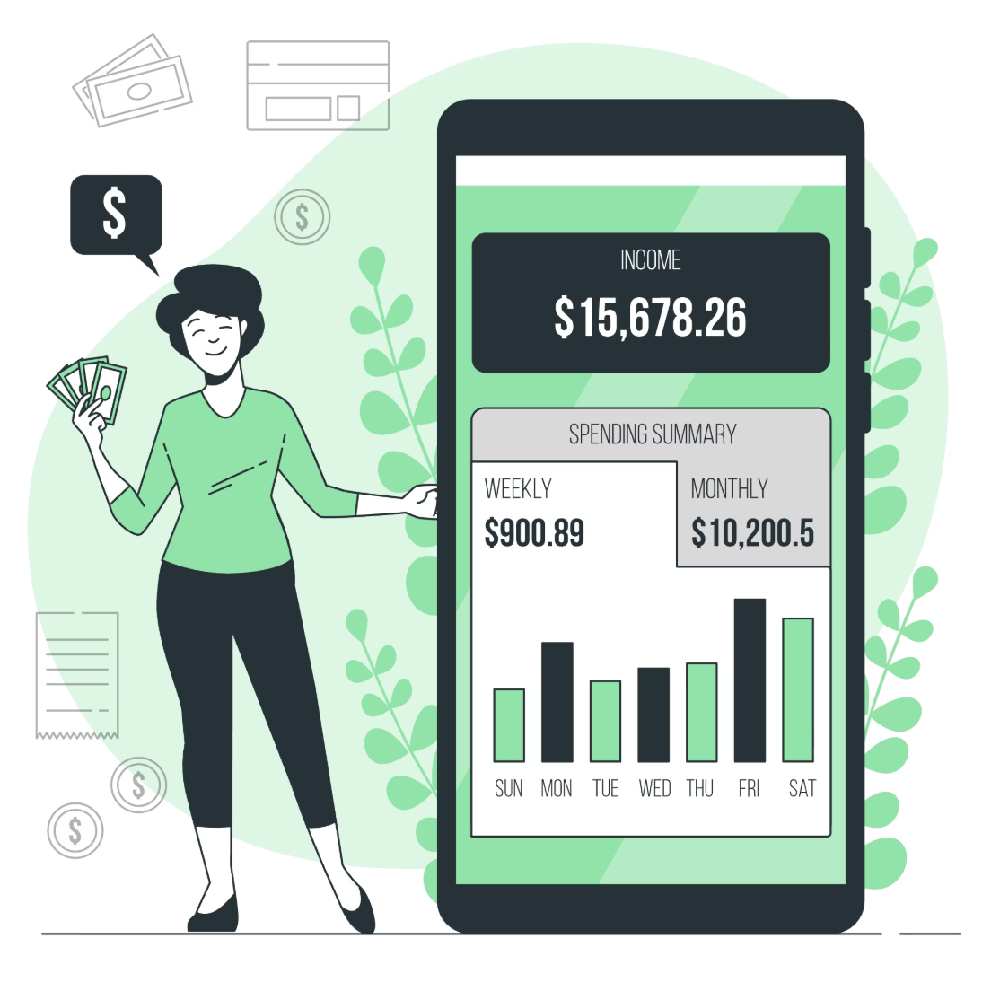
What students actually ask
How long will my money last?
am I saving enough compared to others?
where can I spend less?
when should I exchange currency?
what student offers am I missing?
UniFund answers these through runway prediction, social savings leader board, community-shared cheap discoveries, ML-based exchange suggestions, and aggregated student deals with grocery optimization.

Slide 4

Product — Unifund core features
1. Social Savings Scoreboard
2. Runway Predictor
3. Smart Expense Tracking
Ranks friends based on savings, creating competition and accountability.
Shows how many days money will last at current spending rate.
Manual and photo-based tracking with real-time savings visibility.
4. Student Deals & Grocery Optimiser
5. Currency Exchange Advisor
ML-based suggestions on optimal timing for currency exchange.
Finds cheapest supermarkets, products, and exclusive student offers.

Slide 5


Engagement & behaviour mechanics
UniFund goes beyond tracking — it builds habits and rewards sensible choices.
Savings-meter
Streak rewards
Coupon incentives
Socially visible progress towards savings goals.
Short-run streaks incentivize consistent runway-positive behaviours.
Targeted offers from student-friendly brands that extend runway.

Slide 6

Business impact & monetization
High frequency use → retention
Multi-channel revenue
Affiliate revenue
Subscription tiers + student offers, brand partnerships.
UniFund earns affiliate commission when students purchase groceries, student offers, or financial services through in-app partner links.
Daily runway checks build habit loops; retention anchors lifetime value starting in college.

Slide 7
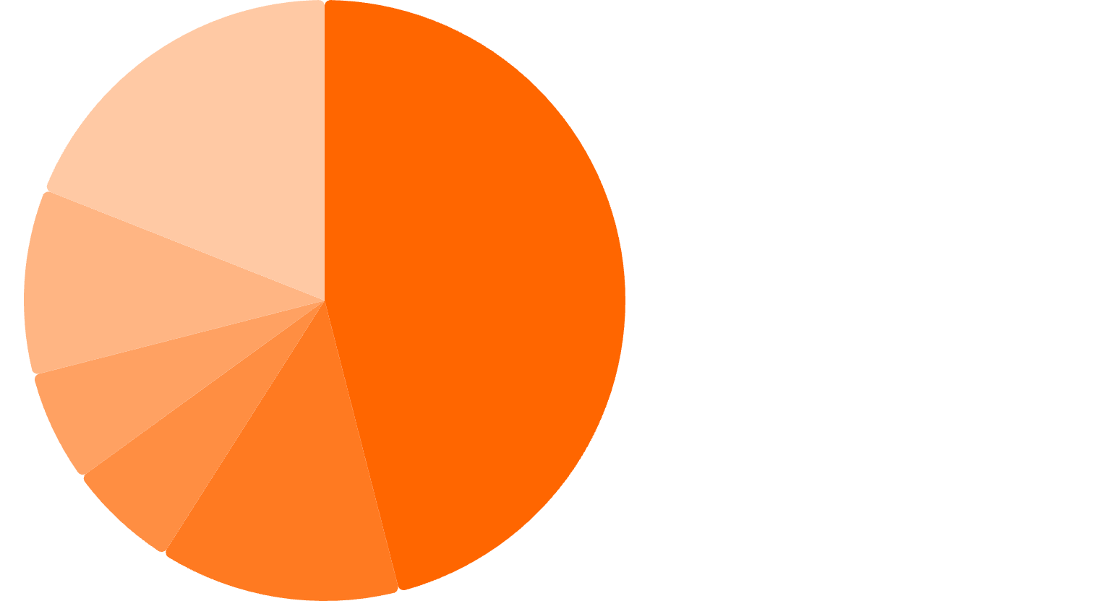
Student Monthly Spending Breakdown (£1,142)
Rent·46%
·46%
·
Groceries·13%
·13%
·
Bills·6%
·6%
·
Transport·6%
·6%
·
Going out & eating out·10%
·10%
·
Others (clothes, subscriptions, health, etc.)·19%
·19%
·
Assume baseline save £900 → with your app save £2,500 (or equivalent). This suggests 2.7× more savings with disciplined tracking and social motivation.

Slide 8

Our Team
Meet the dedicated individuals bringing UniFund to life.
Aditya Patil
Ramya Barri
Sivaavanish Kanagasabapathi
Sudeep Aryan Gaddameedi
Diwakar Gunasekaran
Harry Reynolds

